Slide 1

Chapter 22: Main-Group Elements I: Metals
General Chemistry
Principles and Modern Applications
Petrucci • Harwood • Herring
8th Edition
Philip Dutton
University of Windsor, Canada
N9B 3P4
Prentice-Hall © 2002

Slide 2
Contents
22-1 Group 1: the Alkali Metals
22-2 Group 2: The Alkaline Earth Metals
22-3 Ions in Natural Waters: Hard Water
22-4 Group 13 Metals: Aluminum, Gallium, Indium and Thallium
22-5 Group 14 Metals: Tin and Lead
Focus On Gallium Arsenide

Slide 3
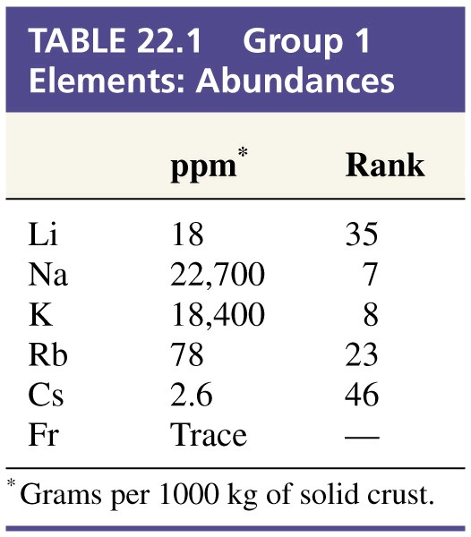
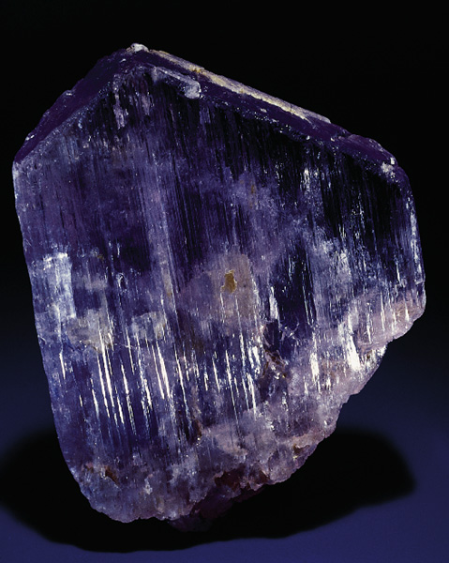
Group 1: The Alkali Metals
Spodumene LiAl(SiO₃)₂

Slide 4
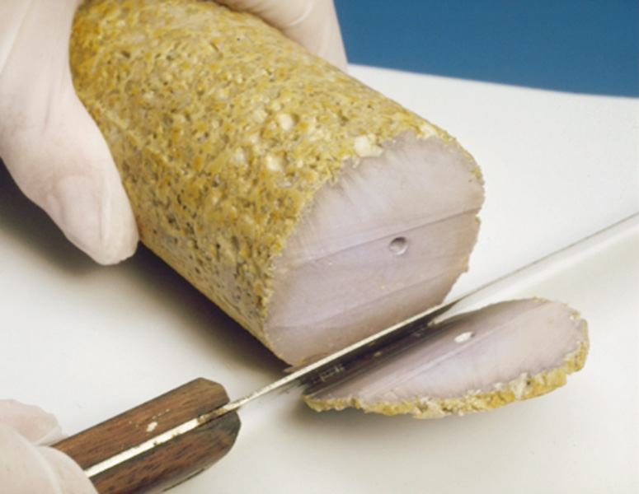
The Alkali Metals
Discoveries are recent.
  Sodium and potassium (1807) by electrolysis.
  Cesium (1860) and rubidium (1861) from emission spectra.
  Francium (1939) from actinium radioactive decay.
Most salts are water soluble.
  Natural brines are good sources.
  Natural deposits allow mining of solids.

Slide 5
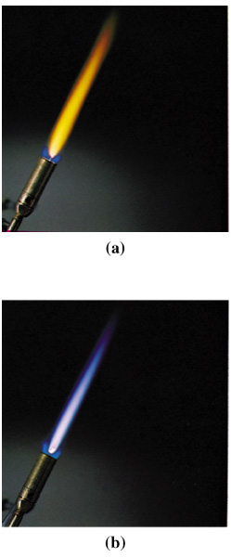
Flame Colors
Na
K

Slide 6
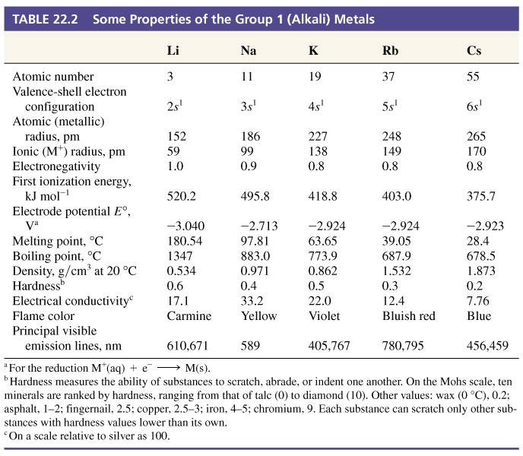
Table 22.2 Some Properties of the Group 1 (Alkali) Metals

Slide 7
Production and Use
Electrolysis:
2 NaCl(l) → 2 Na(l) + Cl₂(g)
Sodium as a reducing agent:
KCl(l) + Na(l) → 2 NaCl(l) + K(g)
TiCl₄ + 4 Na → Ti + 4 NaCl
Notes:
Rb and Cs can be produced in much the same way with Ca metal as the reducing agent.

Slide 8
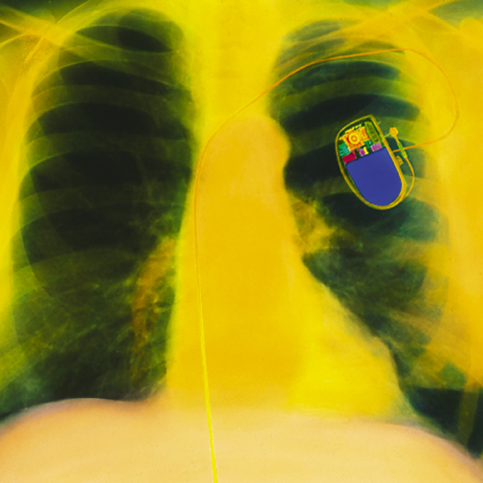
Uses of Alkali Metals
Lithium
  Alloys of Li-Al-Mg for aircraft and space applications.
  Battery anodes.
Sodium
  Heat-transfer medium in
  nuclear reactors.
  Sodium vapor lamps.

Slide 9
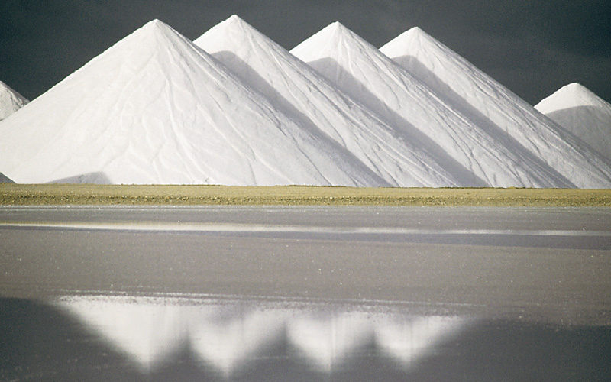
Group I Compounds
Halides
  NaCl 50 million
  tons/year in U.S.
  Preservative, used
  on roads, water
  softener regeneration,
  feed stock for other chemicals
  KCl from natural brines.
  Plant fertilizers, feed stock.

Slide 10
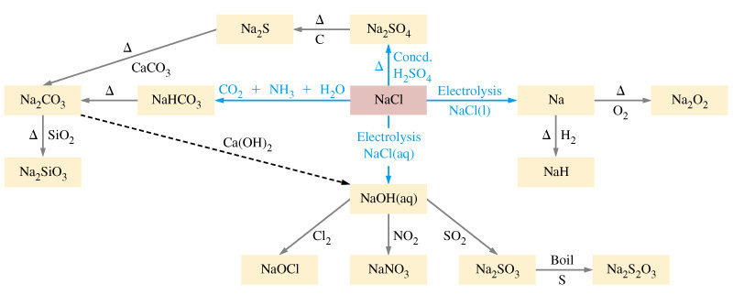
Sodium Compounds

Slide 11
Carbonates
Li₂CO₃ is unstable relative to the oxide.
  Used to treat manic depression (1-2 g/day).
Na₂CO₃ primarily used to manufacture glass.
  Currently mined from rich U.S. resources but can be manufactured by the Solvay process.

Slide 12
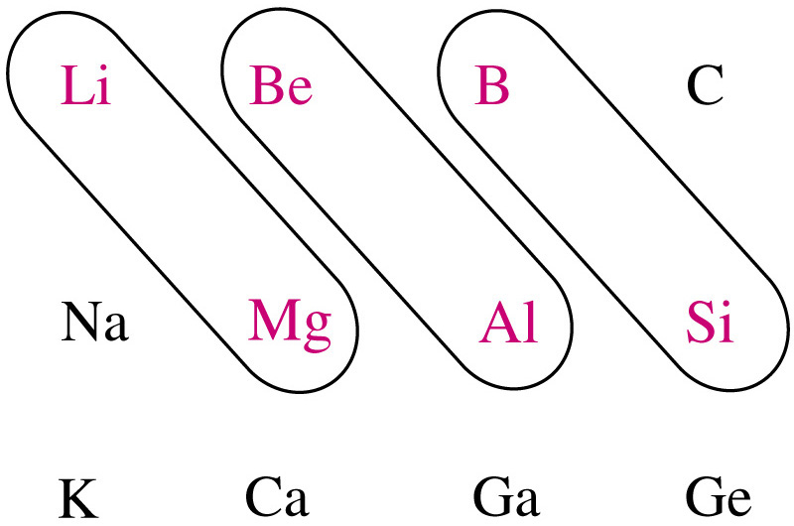
Diagonal Relationships

Slide 13
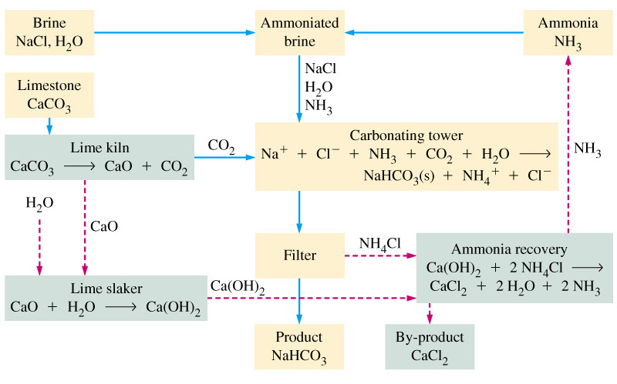
Solvay Process

Slide 14
Sodium Sulfate
H₂SO₄(conc. aq) + NaCl(s) → NaHSO₄(s) + HCl(g)
NaHSO₄(s) + NaCl(s) → Na₂SO₄(s) + HCl(g)
In the Kraft Process for making paper:
Na₂SO₄(s) + 4 C(s) → Na₂S(s) + 4 CO(g)
100 lb/ton paper

Slide 15
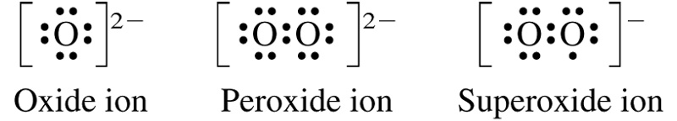
Oxides and Hydroxides
Reaction with oxygen produces several ionic oxides.
  In limited oxygen supplies:
    M₂O (small amounts of Li₂O₂ from Li).
  In excess oxygen:
    Li and Na form the peroxide, M₂O₂.
    K, Rb and Cs form the superoxide MO_{2.}

Slide 16
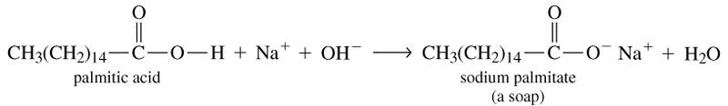
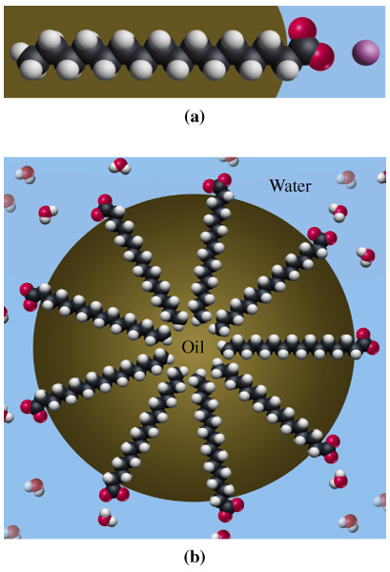
Detergents and Soaps

Slide 17
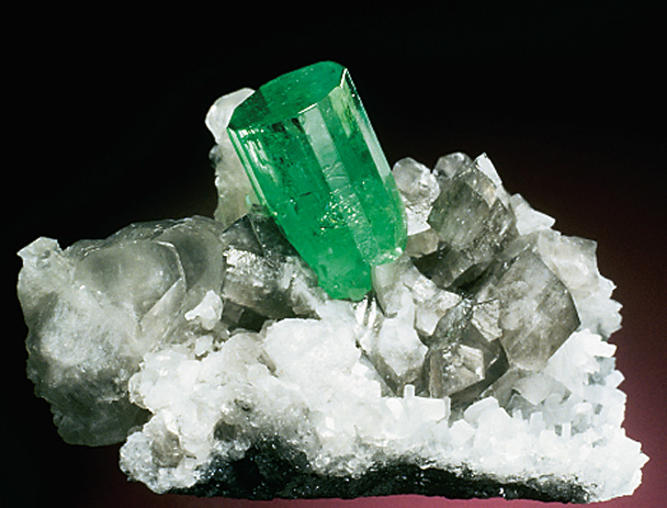
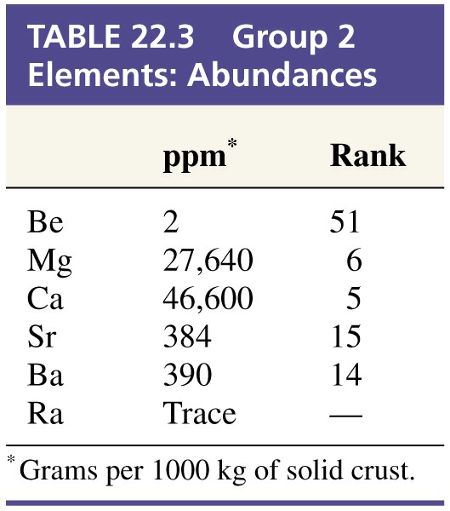
22-2 Group 2: The Alkaline Earth Metals
Emerald is based on the mineral beryl: 3BeO·Al₂O₃ ·6SiO₂

Slide 18
Group 2
Principle forms:
  carbonates, sulfates and silicates
Oxides and hydroxides only sparingly soluble.
  Basic or “alkaline”
Compounds do not decompose on heating.
  Therefore named “earths”
Heavier elements compounds are more reactive and are similar to Group I (also in other respects).

Slide 19
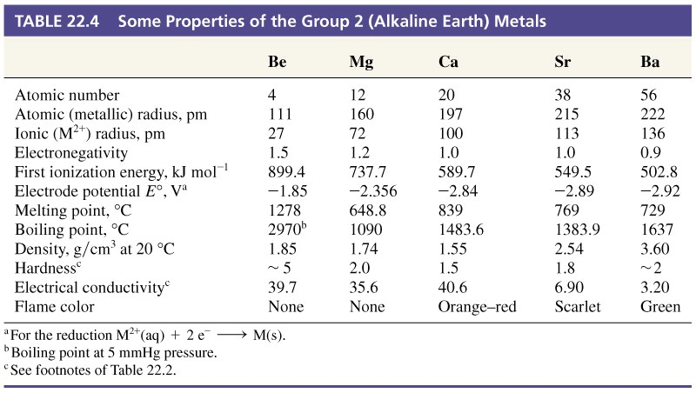
Table 22.4 Some Properties of the Group 2 (Alkaline Earth) Metals

Slide 20
Beryllium
Unreactive toward air and water.
BeO does not react with water, all others from hydroxides.
Be and BeO dissolve in strongly basic solutions to form the BeO₂²⁻ ion (therefore are acidic).
BeCl₂ and BeF₂ melts are poor conductors:
  Therefore they are covalent rather than ionic solids.

Slide 21
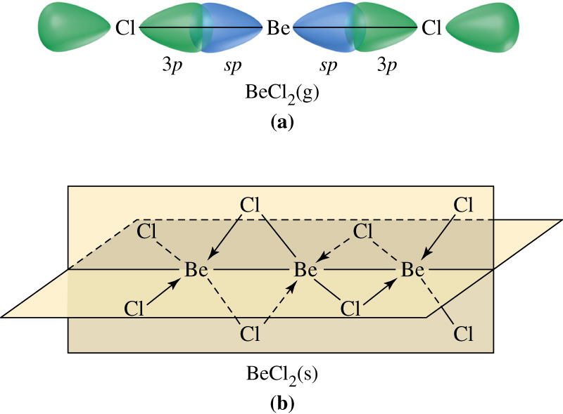
Beryllium Chloride

Slide 22
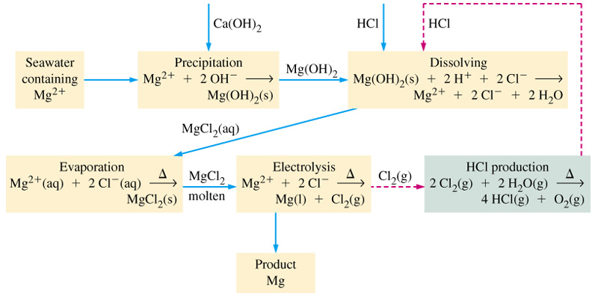
Dow Process for Production of Mg

Slide 23
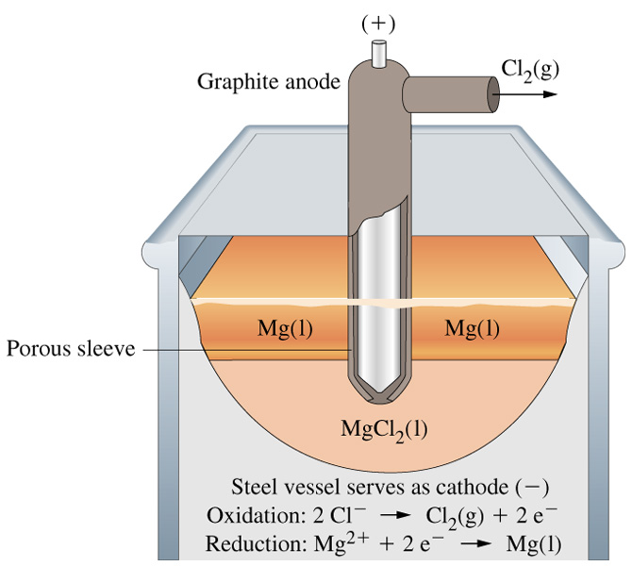
Electrolysis of Molten MgCl₂

Slide 24
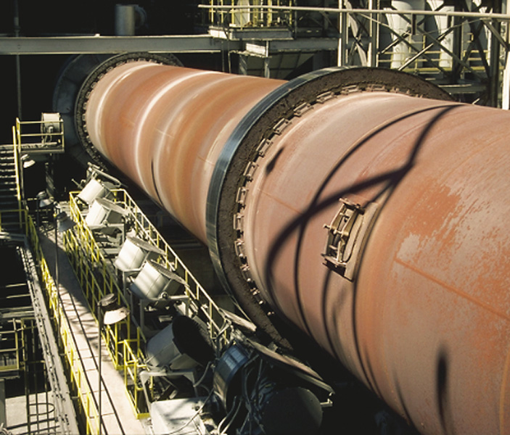
Decomposition of CaCO₃ (lime)
In the lime kiln:
Δ
CaCO₃ → CaO + CO₂
burnt lime
or
quicklime
In the lime slaker:
CaO + H₂O → Ca(OH)₂
slaked lime

Slide 25
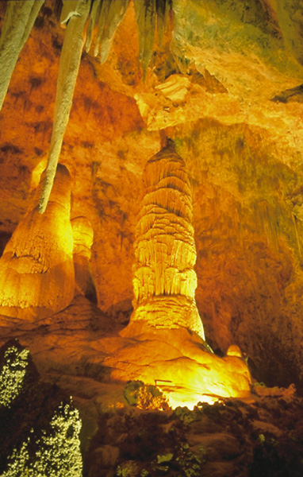
Stalactites and Stalagmites
CO₂ + H₂O → H₃O⁺ + HCO₃⁻
K_{a} = 4.410⁻⁷
HCO₃⁻ + H₂O → H₃O⁺ + CO₃²⁻
K_{a} = 4.710⁻¹¹
CaCO₃(s) + H₂O(l) + CO₂(g) → Ca(HCO₃)₂(aq)

Slide 26
Other Compounds
Gypsum, CaSO₄·2H₂O:
  Plaster of paris CaSO₄·½H₂O by heating bypsum.
  Used in drywall.
BaSO₄ used in X-ray imaging .
Slaked lime used in mortar:
  CaO absorbs water from the cement to form Ca(OH)₂ which subsequently reacts with CO₂ to form CaCO₃.

Slide 27
22-3 Ions in Natural Waters: Hard Water
Rainwater is not chemically pure water.
  Contains dissolved atmospheric gases.
  Once on the ground it may pick up a few to about
  1000 ppm of dissolved substances.
  If the water contains ions capable of forming a precipitate we say that the water is hard.
Hardness may be permanent or temporary.

Slide 28
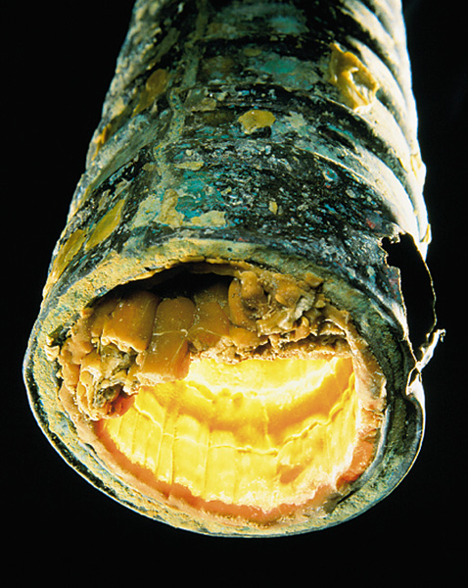
Temporary Hard Water
Contains HCO₃⁻ ion.
  When heated gives CO₃²⁻, CO₂ and H₂O.
  The CO₃²⁻ reacts with multivalent ions to form precipitates.
  (for example CaCO₃, MgCO₃)
Soften water by precipitating the multivalent ions using slaked lime.

Slide 29
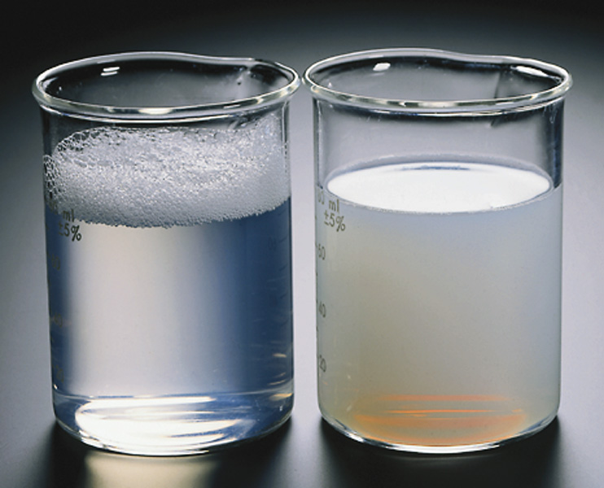
Permanent Hard Water
Contains significant concentrations of anions other than carbonate.
  For example SO₄²⁻, HSO₄⁻.
  Usually soften by precipitating the Ca²⁺ and Mg²⁺ using sodium carbonate leaving sodium salts in solution.
Bathtub ring is caused by
salts of Mg²⁺ and Ca²⁺ of
palmitic acid
(a common soluble soap).

Slide 30
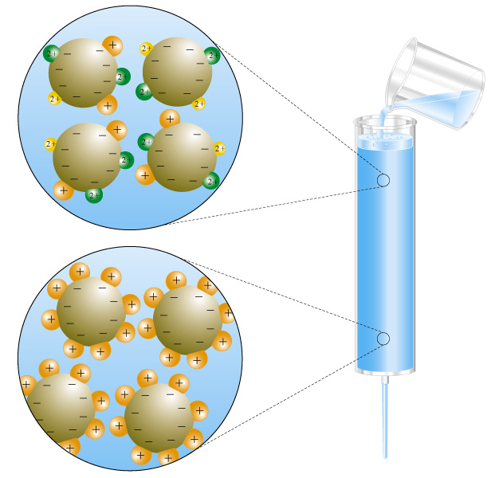
Water Softening
Ion exchange.
  Undesirable cations, Mg²⁺ Ca²⁺ and Fe³⁺ are changed for ions that are not as undesirable, ex. Na⁺.
  Resins or zeolites.

Slide 31
Deionizing
Instead of replacing cations with Na⁺, they are replaced with H^{+.}
Then the anions are replaced with OH⁻.
H⁺(aq) + OH⁻(aq) → H₂O(l)

Slide 32
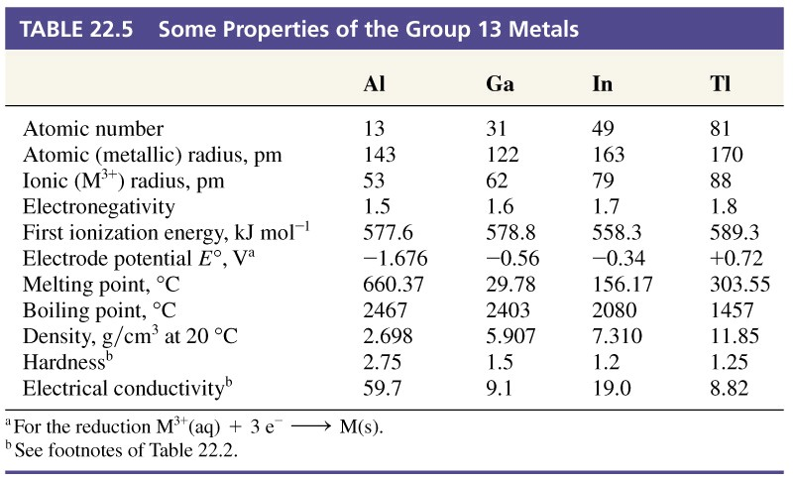
22-4 Group 13 Metals: Aluminum, Gallium, Indium and Thallium

Slide 33
Uses
Aluminum is most important.
  Third most abundant element, 8.3% by mass of crust.
  Lightweight alloys.
  Easily oxidized to Al³⁺.
2 Al(s) + 6 H⁺(aq) → 2 Al³⁺(aq) + 3 H₂(g)
2 Al(s) + 3/2 O₂(g) → Al₂O₃(s) ΔH = -1676 kJ
The Thermite reaction (used in on-site welding of large objects):
2 Al(s) + Fe₂O₃(s) → Al₂O₃(s) + Fe(s)

Slide 34
Uses
Indium.
  Makes low melting alloys.
  Low-temperature transistors and photoconductors.
Thallium
  Extremely toxic. Few industrial uses.
  Tl₂Ba₂Ca₂Cu₃O_{8+x} exhibits superconductivity up to 125K.

Slide 35
Oxidation States
Al almost exclusively 3+.
In and Ga both 3+ and 1+.
Tl both 1+ and 3+.
  Tl⁺ resembles Group 1.
  [Xe]4f¹⁴5d¹⁰6s² – the inert pair effect.

Slide 36
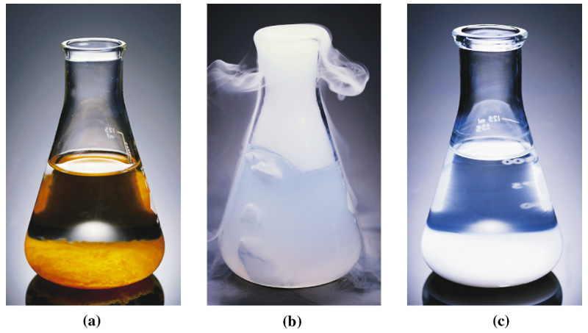
Purification of Bauxite
ppt Fe(OH)₃
with OH⁻ and filter.
Make Al(OH)₄⁻ acidic with CO₂.
Precipitated
Al(OH)₃.

Slide 37
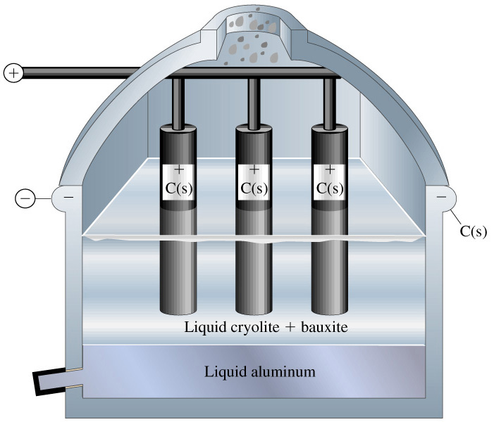
Production of Aluminum

Slide 38
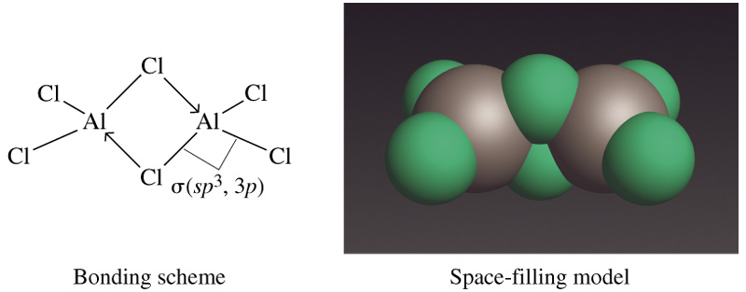
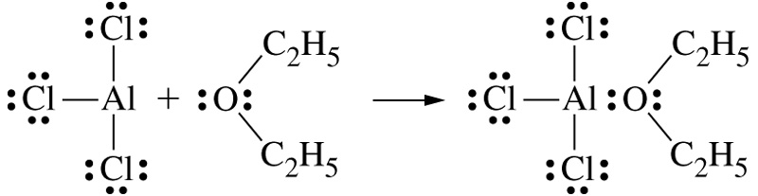
Aluminum Halides

Slide 39
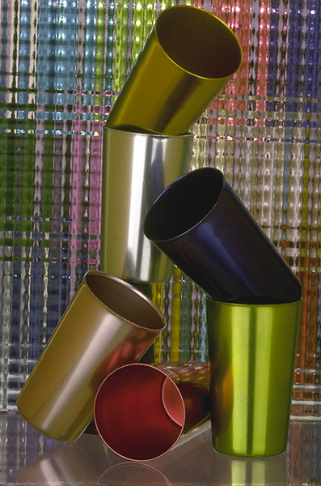
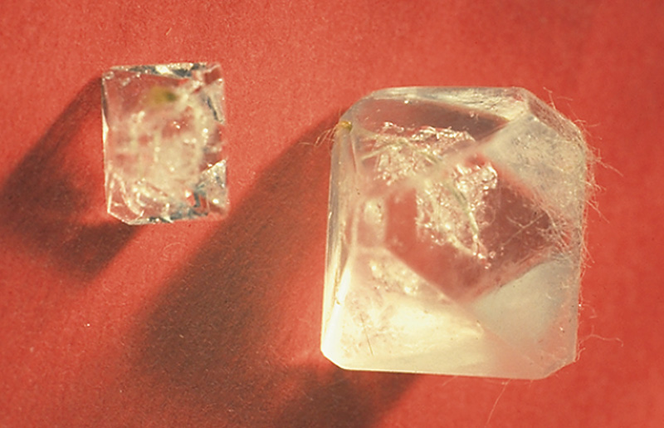
Aluminum and Alums

Slide 40
22-5 Group 14 Metals: Tin and Lead
Properties vary through this group.
Tin and Lead are metallic
  +2 and +4 oxidation states
  α and β forms, β less stable < 13 C, tin pest or tin disease.
Germanium is metalloid.
Silicon, though a semiconductor is mainly nonmetallic.
Carbon is a nonmetal.

Slide 41
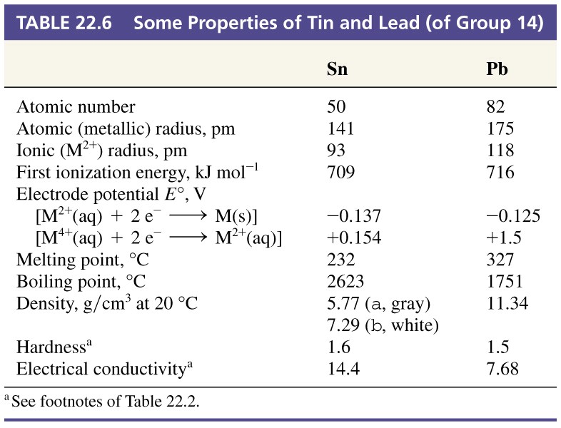
Table 22.6 Some Properties of Tin and Lead (of Group 14)

Slide 42
Tin and Lead Ores and Uses
Cassiterite ore, SnO₂, reduced with C to Sn.
Galena, PbS, roasted in air then reduced with C.
Alloys of Sn
  Solders
  Bronze (90% Cu, 10% Sn
  Pewter (85% Sn, 7% Cu, 6% Bi, 2% Sb)
Pb
  Pimary use in storage batteries.
  Radiation shields.

Slide 43
Oxides
Lead
  PbO, litharge, yellow (ceramics, cements, batteries).
  PbO₂, red brown (matches, storage batteries).
  Pb₃O₄, mixed oxide known as red lead, red (metal-protecting paints).
Tin
  SnO₂ (jewelry abrasive)

Slide 44
Halides
SnCl₂
  Good reducing agent.
    Quantitative analysis of iron ores.
SnCl₄
  Formed from Sn and Cl₂, obtained recovering Sn.
SnF₂
  Anti-cavity additive to toothpaste.

Slide 45
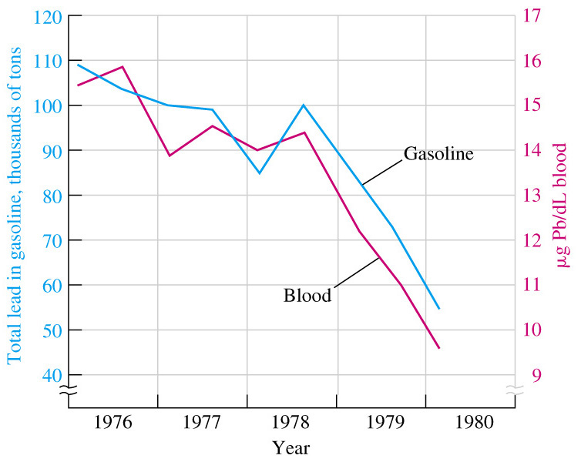
Lead Poisoning
Extensive use of Pb in plumbing systems, utensils, pottery glazes and paints, and gasoline additives.
Pb interferes with heme metabolism.
Mild poisoning:
  Nervousness and depression.
Severe poisoning:
  Nerve, brain and kidney damage.

Slide 46
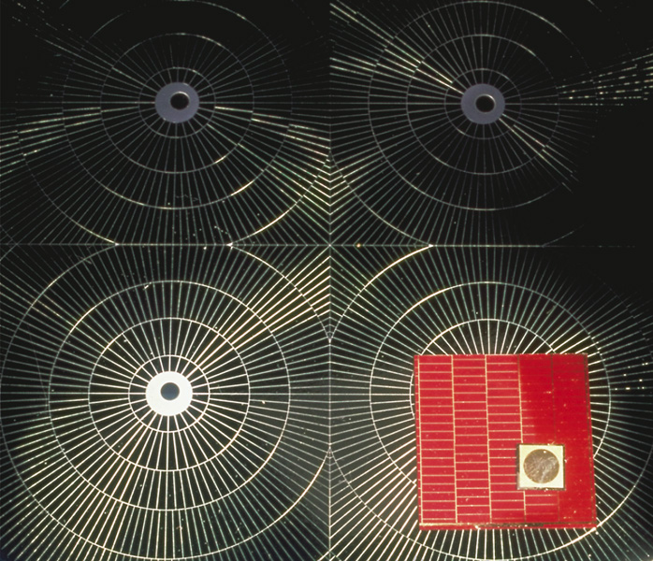
Focus On Gallium Arsenide
Solar Cells
LEDs
Diode LASERs
  CD systems.
  Fiber optic systems.
Intrinsic semiconductor
  Tunable band gap (add P)
  Various emission 540-890 nm.

Slide 47
Chapter 22 Questions
Develop problem solving skills and base your strategy not on solutions to specific problems but on understanding.
Choose a variety of problems from the text as examples.
Practice good techniques and get coaching from people who have been here before.

